Slide 1











DISCUSSIFY “ Where Ideas Flourish and Communities Thrive! "
Presented by:- Rahul Singh Manu Vijay Vardhan Piyush Sharma Anurag Singh
Under the guidance of Ms. Priyanka Garg

Slide 2
TABLE OF CONTENTS
Introduction
Work planning
01
02
progress
03
04
methodology

Slide 3



Introduction
01

Slide 4


Project overview
Discussify is a pioneering application revolutionizing online discussion forums by harnessing the dynamic capabilities of Flutter for front-end development and the robust infrastructure of Firebase for back-end services.
Our primary objective is to create a responsive and user-friendly platform that fosters real-time interactions among users while prioritizing security and integrity.
Through the integration of Flutter and Firebase, Discussify aims to redefine the landscape of online discussions by promoting meaningful interactions and connections within digital communities.

Slide 5

objective
Create a Responsive Platform
Community Building
Seamless User Experience
User Authentication and Security
Content Moderation
Scalability and Performance
Integration of Advanced Features
Real-Time Data Synchronization

Slide 6

Literature review
Smith, J. et al. (2021). "Enhancing User Engagement in Mobile Discussion Forums: A Review." Journal of Mobile Applications Research, 10(2), 45-60.
Patel, R. et al. (2019). "A Comparative Study of Flutter and React Native for Cross-Platform Mobile Development." International Journal of Mobile Software Engineering, 6(1), 112-128.
Gupta, S. et al. (2020). "Real-Time Interaction Technologies for Mobile Applications: A Comprehensive Survey." IEEE Transactions on Mobile Computing, 19(3), 321-337.
Khan, A. et al. (2018). "Effective Content Moderation Techniques in Online Discussion Forums: A Systematic Review." ACM Transactions on Internet Technology, 15(4), 123-140.

Slide 7
Work Planning
02

Slide 8
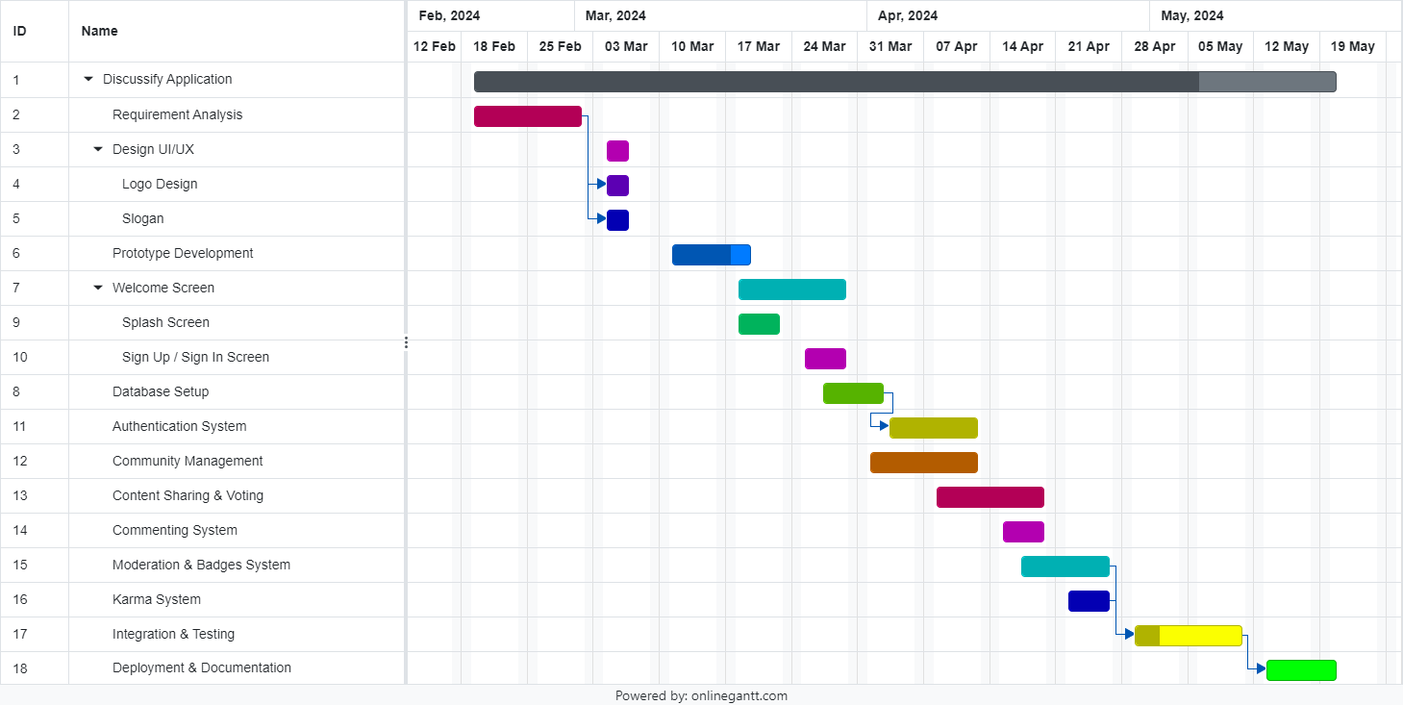

Slide 9
Methodology
03

Slide 10
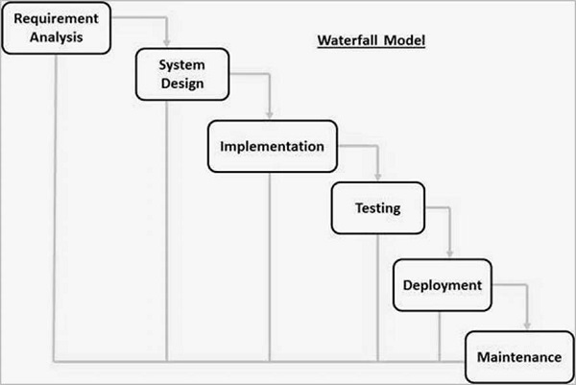

Slide 11
Information gathering Final Report

Slide 12
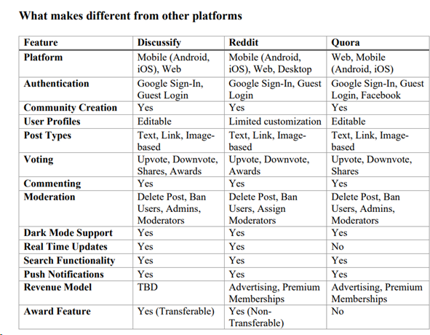

Slide 13
Unique Features
Editable user profiles
Transferable Awards
Guest Login Karma Real-Time Updates

Slide 14
Progress
04

Slide 15
App Name & Tagline
“ Where Ideas Flourish And Communities Thrive! ”
Discussify
"Where Ideas Flourish": This means Discussify is a place where ideas can grow and develop freely.
"And Communities Thrive": It suggests that Discussify is also about building strong communities where people come together, engage, and support each other.
Discussify is a blend of two words: "discuss" and "amplify". It encapsulates the essence of the platform, which is to facilitate discussions and amplify voices within communities.

Slide 16
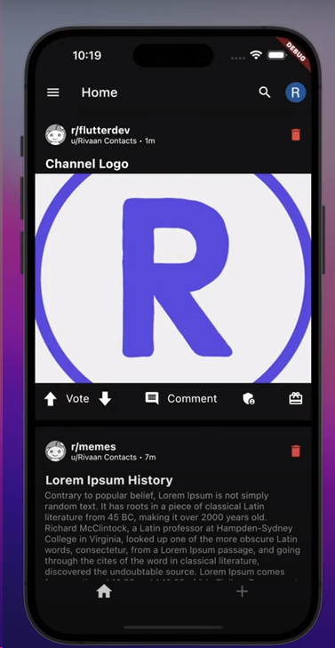
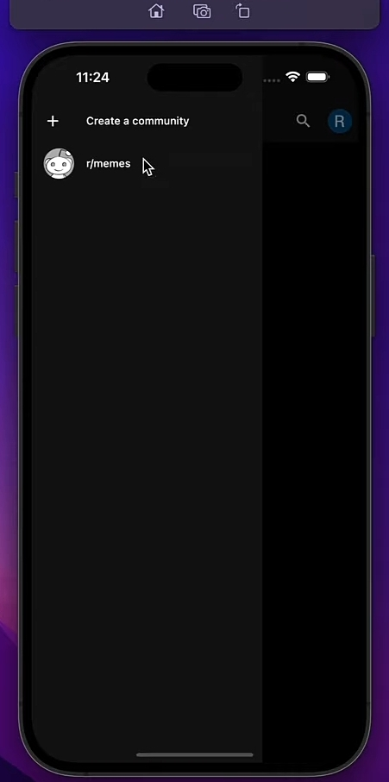
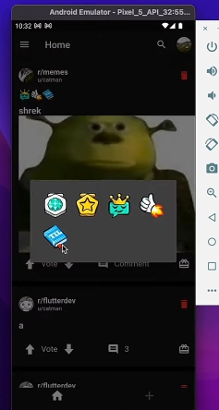
Prototype

Slide 17


Logo

Slide 18
Progress Report
90%
Task Finished
10%
Task Ongoing

Slide 19




THANKS!
Does anyone have any questions?

